Slide 1


Git
- Sunil kumar

Slide 2


Table Of Content
VCS
What is Git?
Git init
Git add
Git status
Git commit
Git push
Git pull
Git fetch
Git branch
Git checkout
Git merge
Git rebase
Git cherry-pick
Git reset
Pull Request
Architecture
Operations Roadmap 2013
Big Data, Big Experience, Big Expertise - Fast
previous
next
previous
next

Slide 3
VCS – Version Control System
Version control is a system that records changes to a file or set of files over time so that you can recall specific versions later.
For example: If you are a graphic or web designer and want to keep every version of an image or layout (which you would most certainly want to), a Version Control System (VCS) is a very wise thing to use.
It allows you to revert files back to a previous state, revert the entire project back to a previous state, compare changes over time, see who last modified something that might be causing a problem, who introduced an issue and when, and more.
Using a VCS also generally means that if you screw things up or lose files, you can easily recover.
Operations Roadmap 2013
Big Data, Big Experience, Big Expertise - Fast
previous
next
previous
next

Slide 4
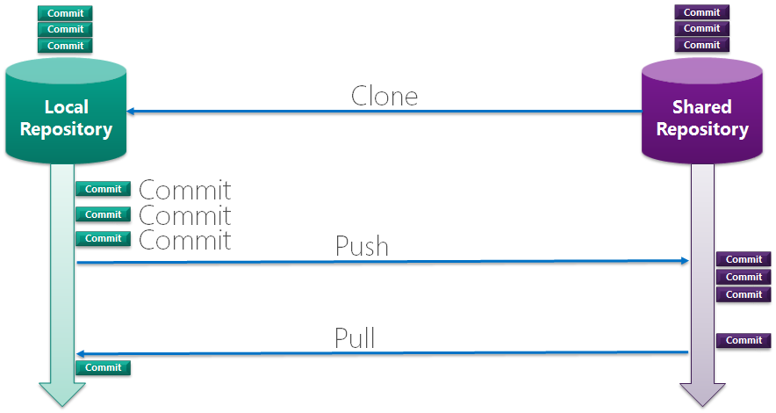
Git Workflow
Operations Roadmap 2013
Big Data, Big Experience, Big Expertise - Fast
previous
next
previous
next

Slide 5
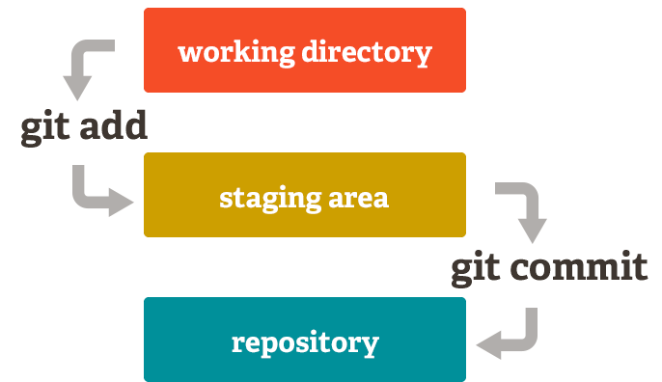
Operations Roadmap 2013
Big Data, Big Experience, Big Expertise - Fast
previous
next
previous
next

Slide 6
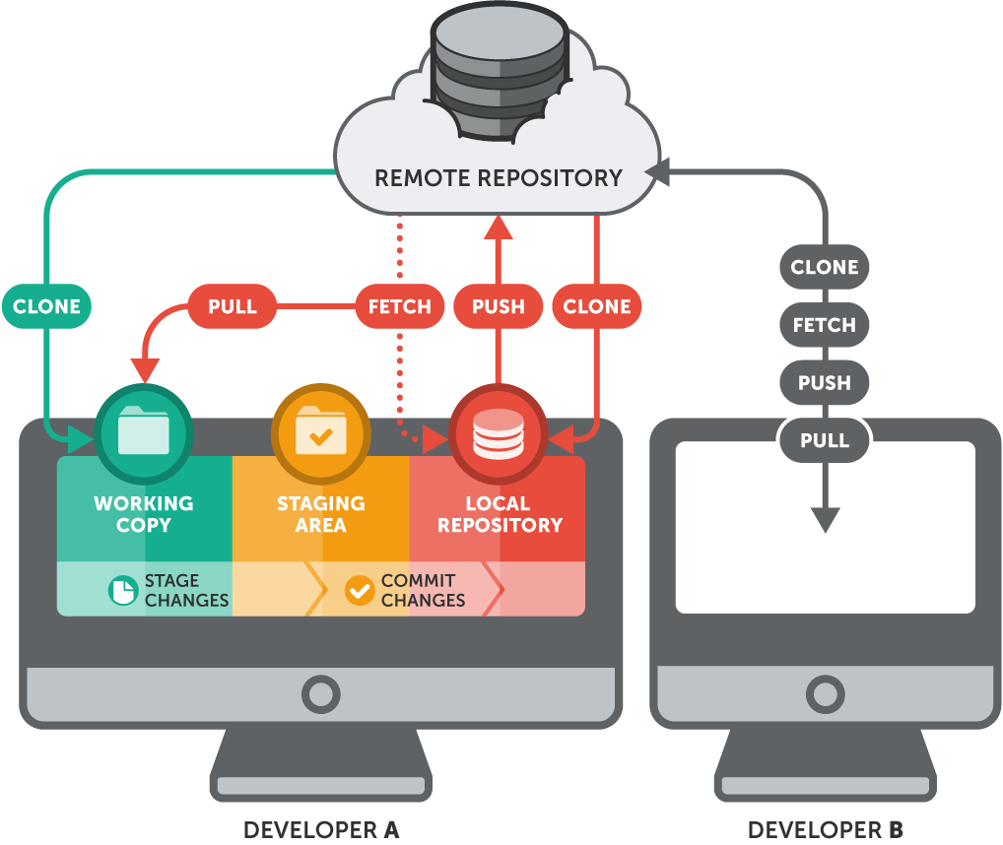
Operations Roadmap 2013
Big Data, Big Experience, Big Expertise - Fast
previous
next
previous
next

Slide 7
git clone
- clone an already existing repo
Operations Roadmap 2013
Big Data, Big Experience, Big Expertise - Fast
previous
next
previous
next

Slide 8
git init
- initialize a git repo
Operations Roadmap 2013
Big Data, Big Experience, Big Expertise - Fast
previous
next
previous
next

Slide 9
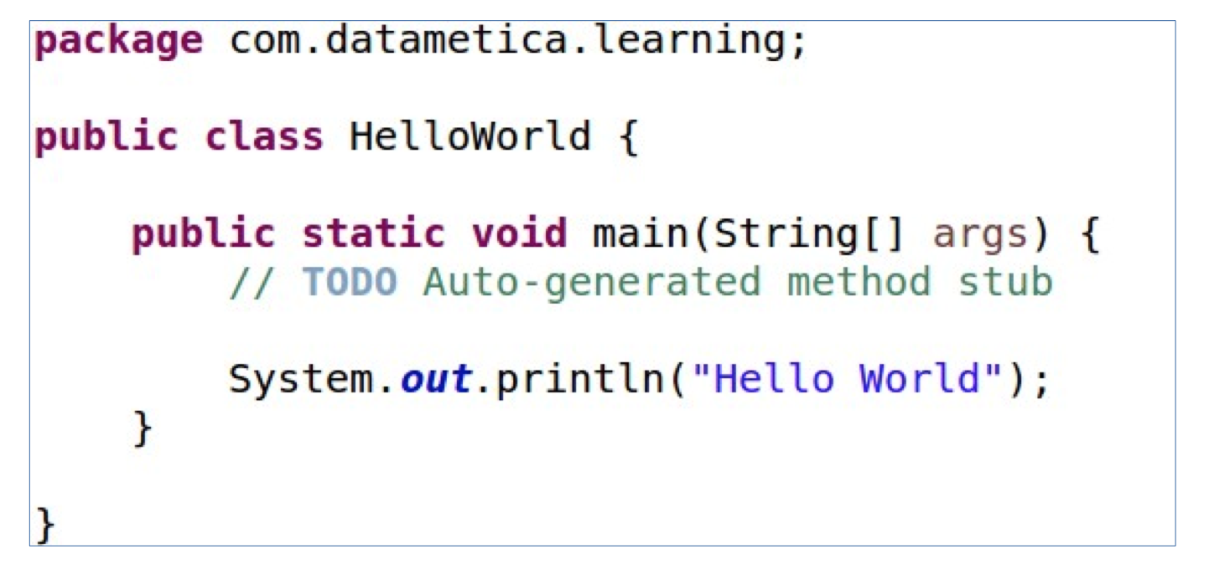
Anatomy of a class
Operations Roadmap 2013
Big Data, Big Experience, Big Expertise - Fast
previous
next
previous
next

Slide 10
git add
- add files to staging area
Operations Roadmap 2013
Big Data, Big Experience, Big Expertise - Fast
previous
next
previous
next

Slide 11
git status
- check the status
Operations Roadmap 2013
Big Data, Big Experience, Big Expertise - Fast
previous
next
previous
next

Slide 12
git commit
- commit the changes from staging area
Operations Roadmap 2013
Big Data, Big Experience, Big Expertise - Fast
previous
next
previous
next

Slide 13
git push
- push commits from local repo to shared repo
Operations Roadmap 2013
Big Data, Big Experience, Big Expertise - Fast
previous
next
previous
next

Slide 14
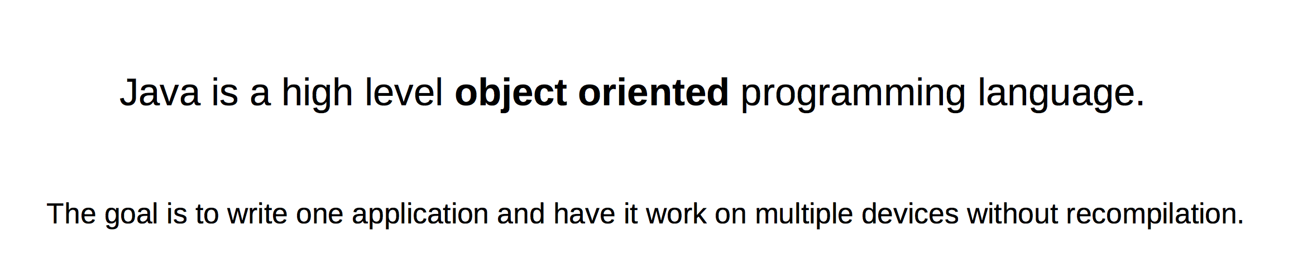
What is Java?
Operations Roadmap 2013
Big Data, Big Experience, Big Expertise - Fast
previous
next
previous
next

Slide 15
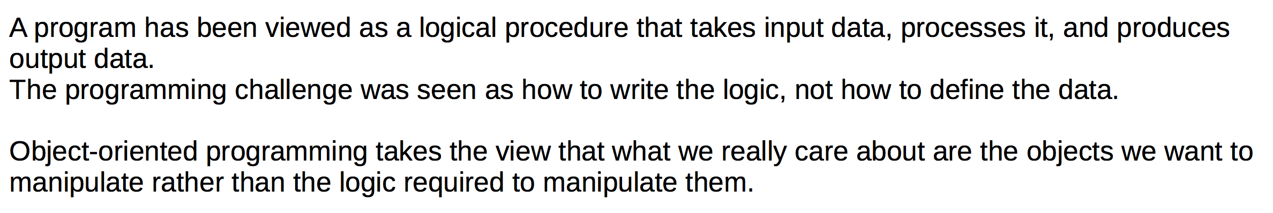
Object Oriented Programming
Operations Roadmap 2013
Big Data, Big Experience, Big Expertise - Fast
previous
next
previous
next

Slide 16
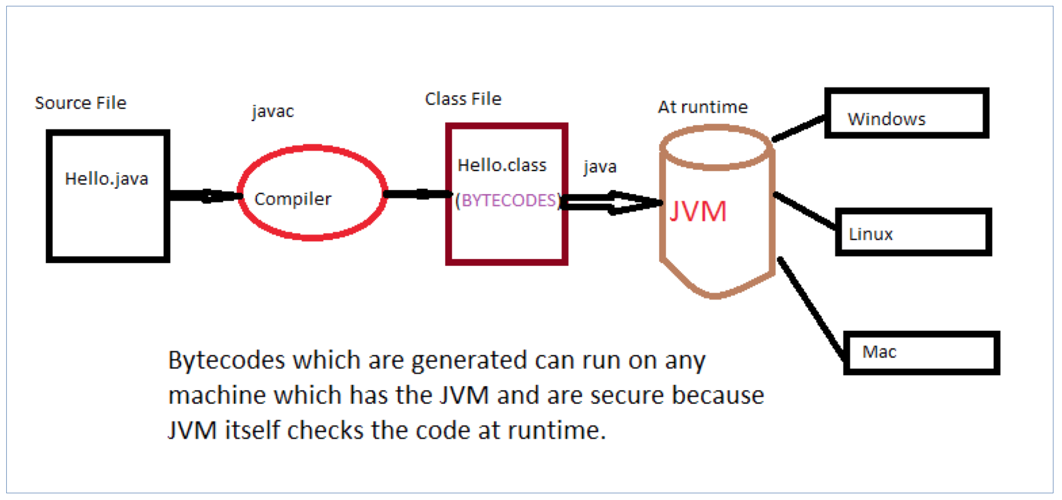
Platform Independency
Operations Roadmap 2013
Big Data, Big Experience, Big Expertise - Fast
previous
next
previous
next

Slide 17
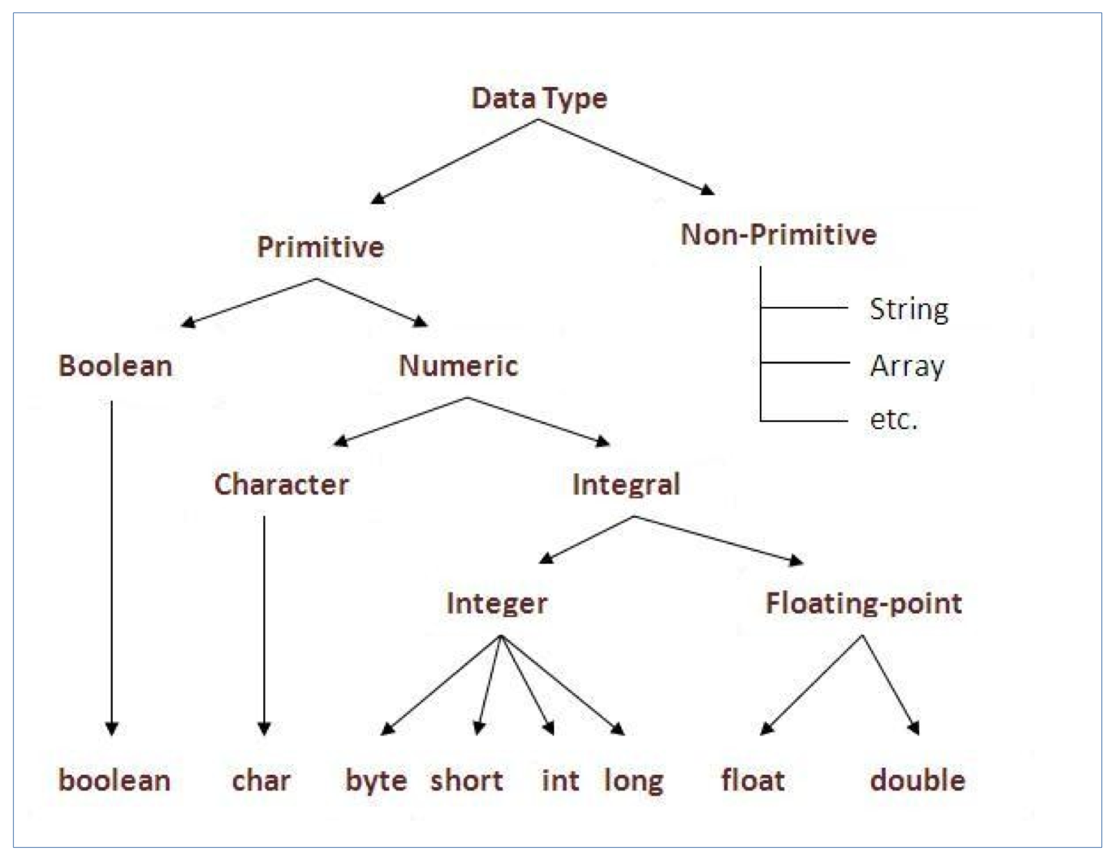
Data Types
Operations Roadmap 2013
Big Data, Big Experience, Big Expertise - Fast
previous
next
previous
next

Slide 18
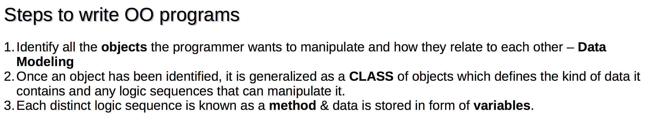
Classes & Objects
Operations Roadmap 2013
Big Data, Big Experience, Big Expertise - Fast
previous
next
previous
next

Slide 19
git branch
- for managing different branches
Operations Roadmap 2013
Big Data, Big Experience, Big Expertise - Fast
previous
next
previous
next

Slide 20
git checkout
- switch between branches
Operations Roadmap 2013
Big Data, Big Experience, Big Expertise - Fast
previous
next
previous
next

Slide 21
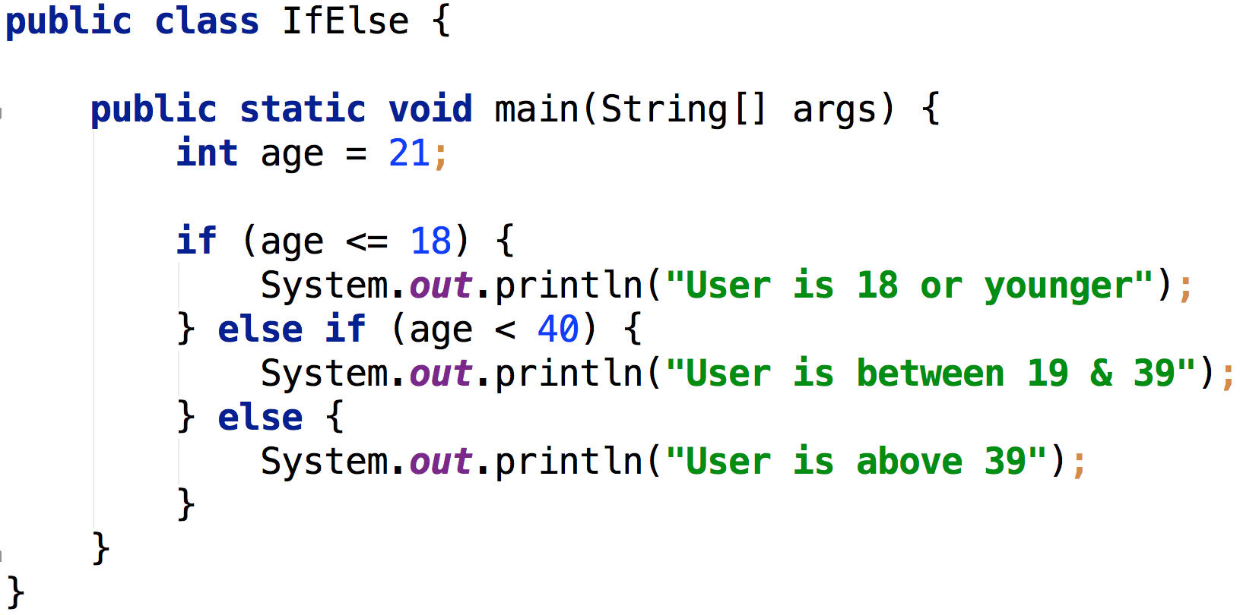
Conditional statements – If Else
Operations Roadmap 2013
Big Data, Big Experience, Big Expertise - Fast
previous
next
previous
next

Slide 22
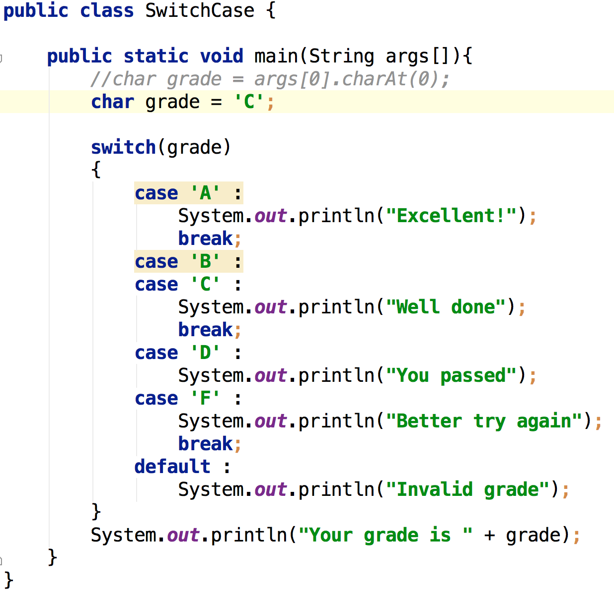
Conditional statements – Switch Case
Operations Roadmap 2013
Big Data, Big Experience, Big Expertise - Fast
previous
next
previous
next

Slide 23
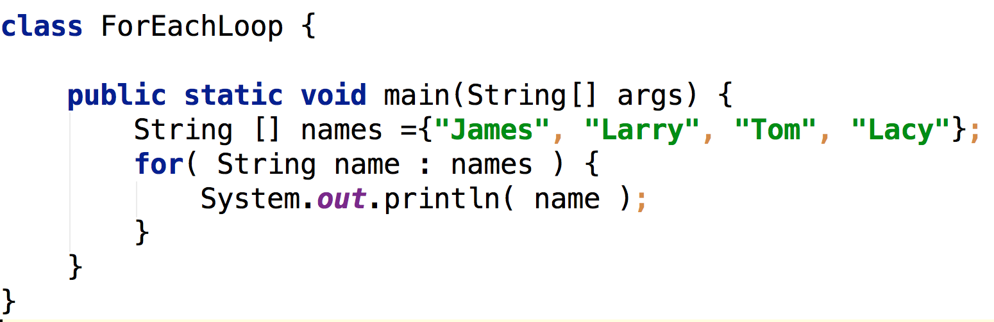
Loops – foreach
Operations Roadmap 2013
Big Data, Big Experience, Big Expertise - Fast
previous
next
previous
next

Slide 24
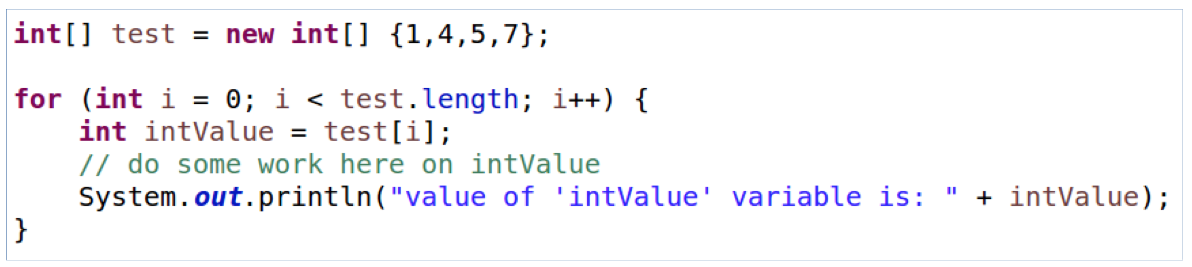
Loops - for
Operations Roadmap 2013
Big Data, Big Experience, Big Expertise - Fast
previous
next
previous
next

Slide 25
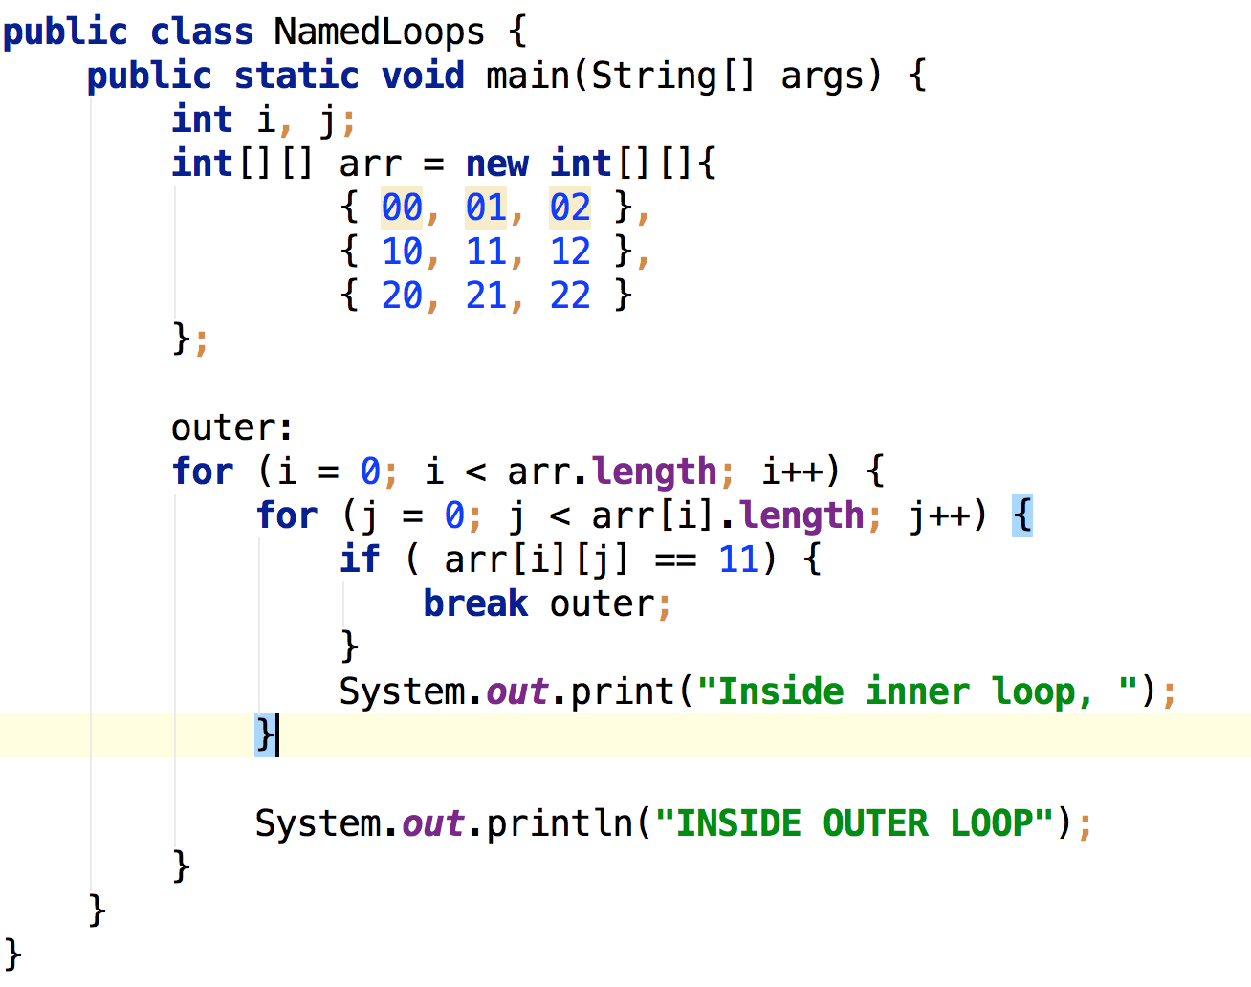
Named Loops
Operations Roadmap 2013
Big Data, Big Experience, Big Expertise - Fast
previous
next
previous
next

Slide 26
Named Loops
Operations Roadmap 2013
Big Data, Big Experience, Big Expertise - Fast
previous
next
previous
next

Slide 27
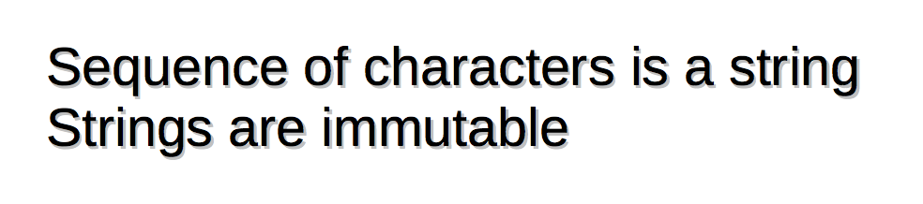
Strings
Operations Roadmap 2013
Big Data, Big Experience, Big Expertise - Fast
previous
next
previous
next

Slide 28
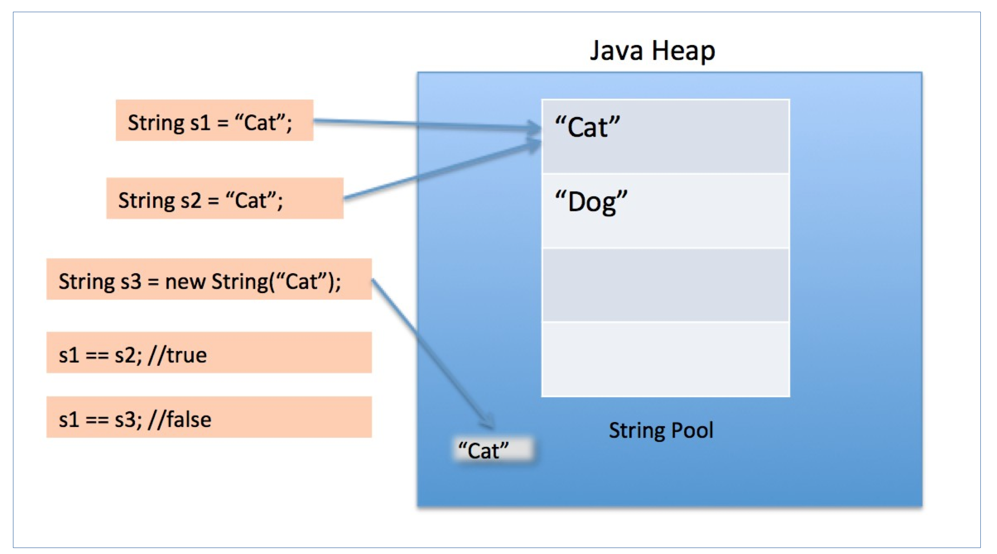
String Pool
Operations Roadmap 2013
Big Data, Big Experience, Big Expertise - Fast
previous
next
previous
next

Slide 29
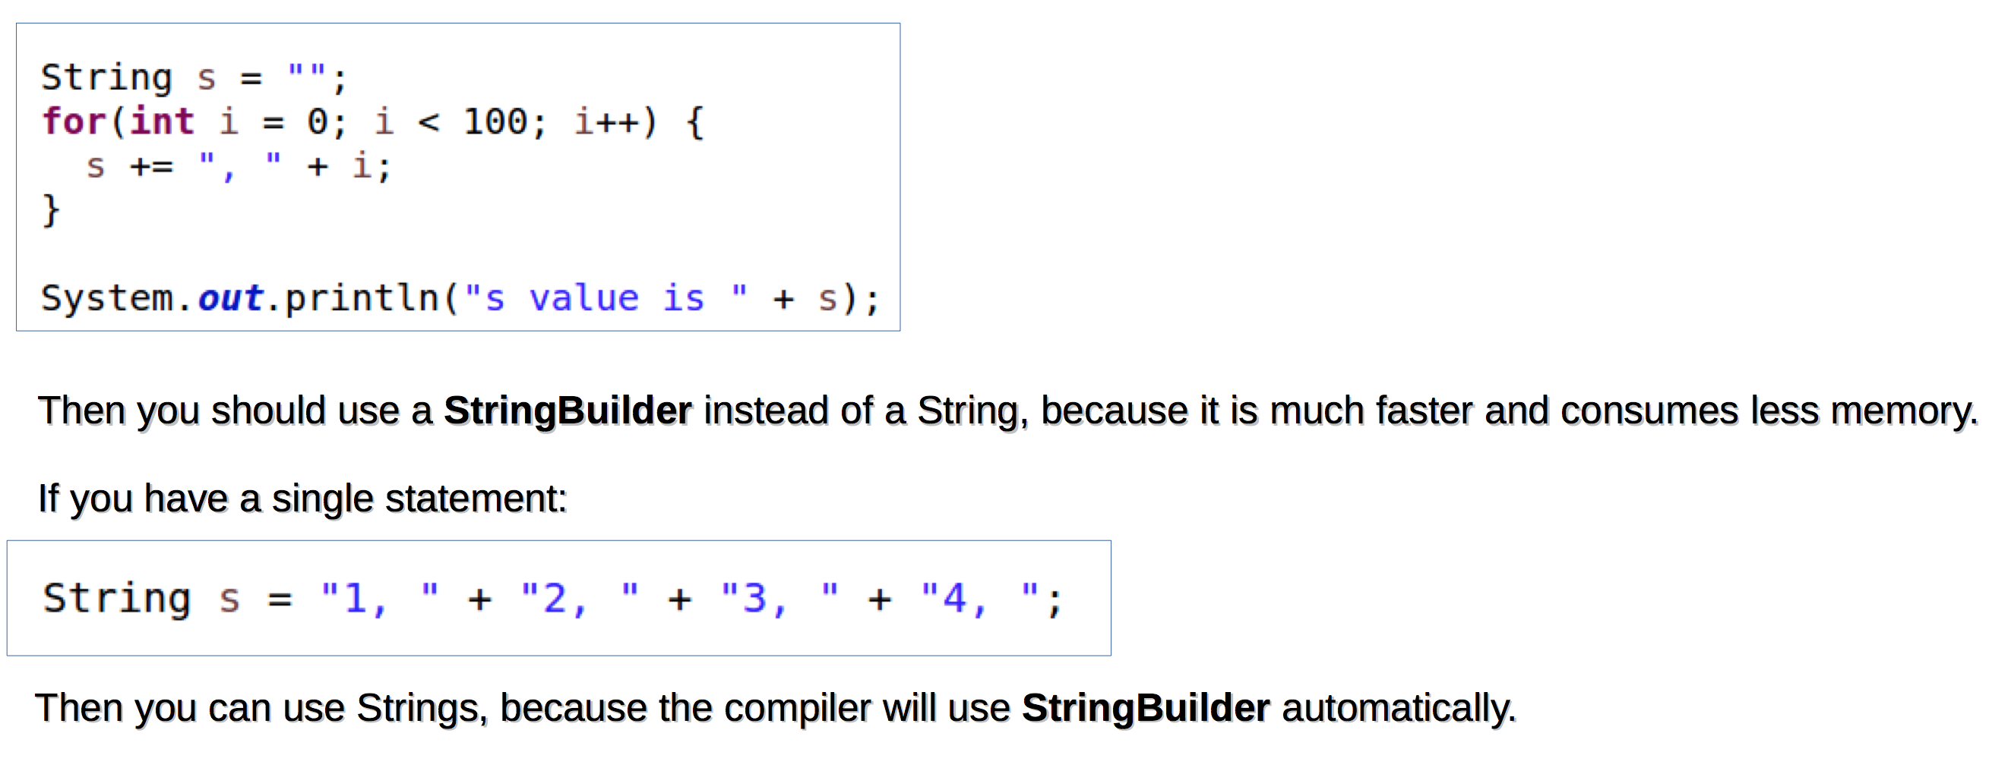
String Builder
Operations Roadmap 2013
Big Data, Big Experience, Big Expertise - Fast
previous
next
previous
next

Slide 30
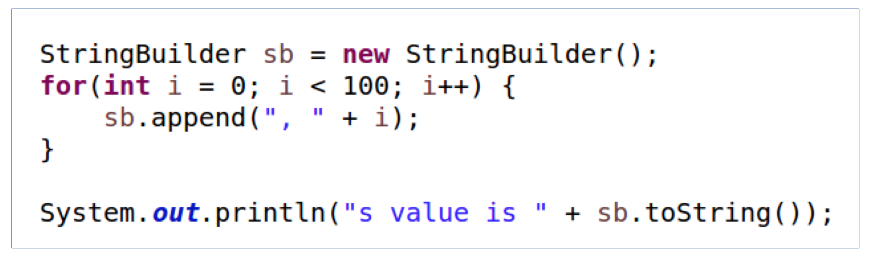
String Builder
Operations Roadmap 2013
Big Data, Big Experience, Big Expertise - Fast
previous
next
previous
next

Slide 31
String Buffer
Operations Roadmap 2013
Big Data, Big Experience, Big Expertise - Fast
previous
next
previous
next

Slide 32
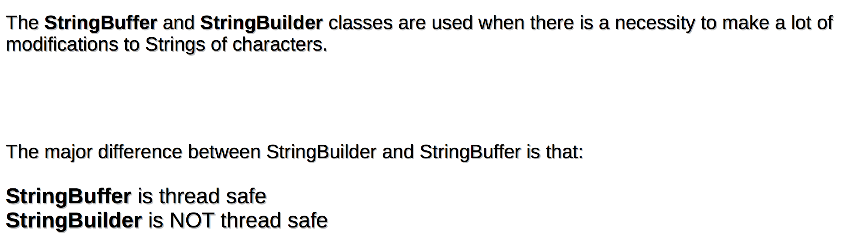
String Buffer
Operations Roadmap 2013
Big Data, Big Experience, Big Expertise - Fast
previous
next
previous
next

Slide 33
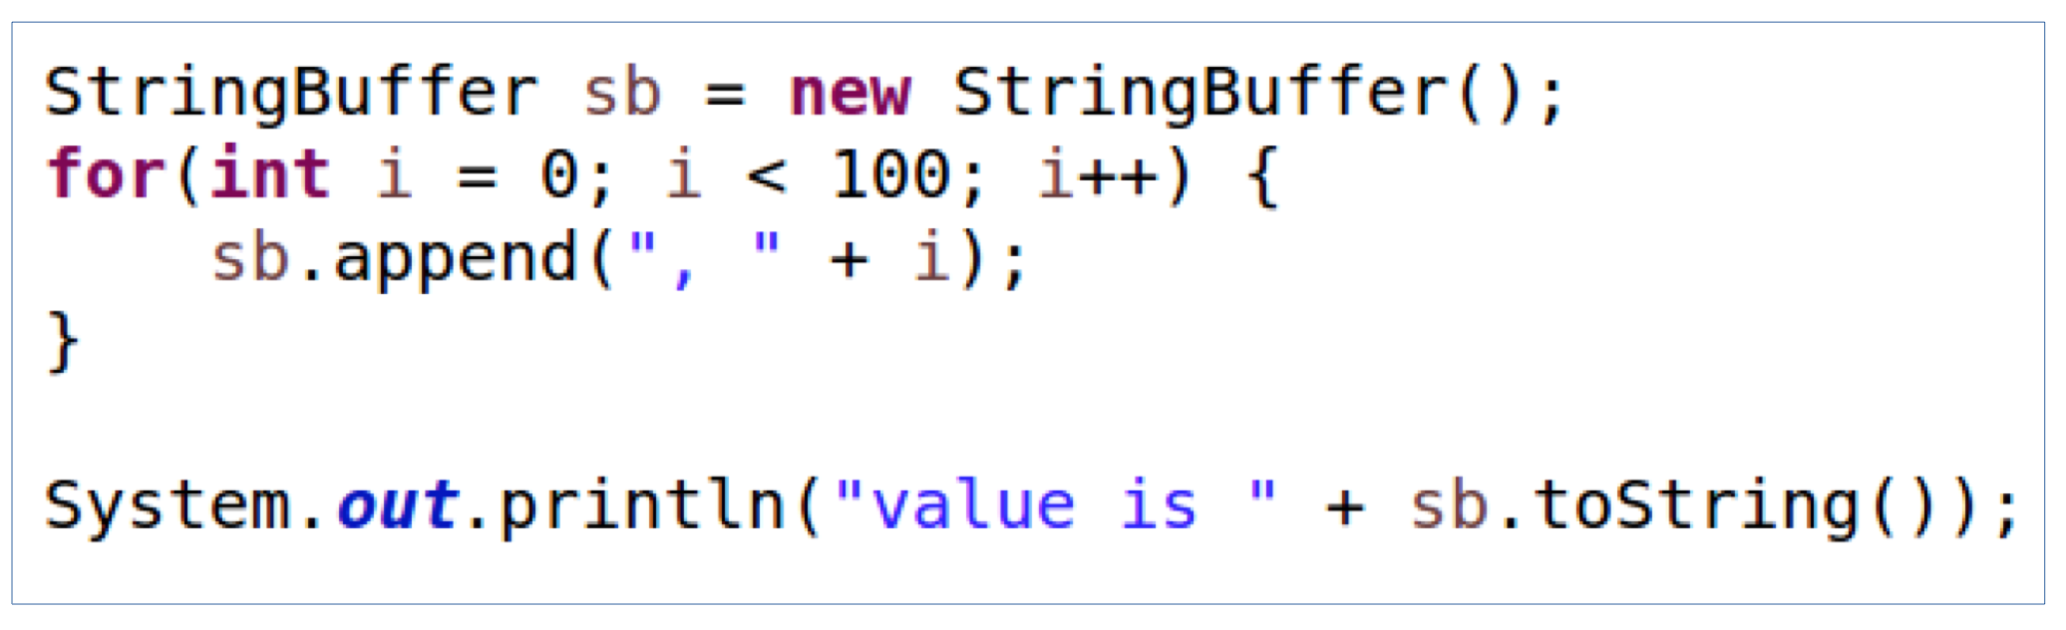
String Buffer
Operations Roadmap 2013
Big Data, Big Experience, Big Expertise - Fast
previous
next
previous
next

Slide 34
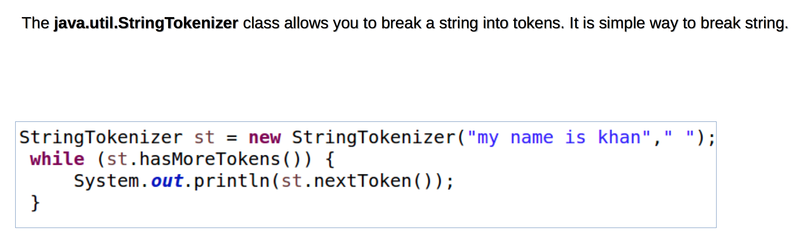
String Tokenizer
Operations Roadmap 2013
Big Data, Big Experience, Big Expertise - Fast
previous
next
previous
next

Slide 35
git pull
- pull changes from shared repo to current branch
Operations Roadmap 2013
Big Data, Big Experience, Big Expertise - Fast
previous
next
previous
next

Slide 36
git fetch
- fetch changes from shared repo to local repo
Operations Roadmap 2013
Big Data, Big Experience, Big Expertise - Fast
previous
next
previous
next

Slide 37
git merge
- merge changes from another branch to current branch
Operations Roadmap 2013
Big Data, Big Experience, Big Expertise - Fast
previous
next
previous
next

Slide 38
git merge
- merge changes from another branch to current branch
Operations Roadmap 2013
Big Data, Big Experience, Big Expertise - Fast
previous
next
previous
next

Slide 39
git rebase
- rewrite your commit history
Operations Roadmap 2013
Big Data, Big Experience, Big Expertise - Fast
previous
next
previous
next

Slide 40
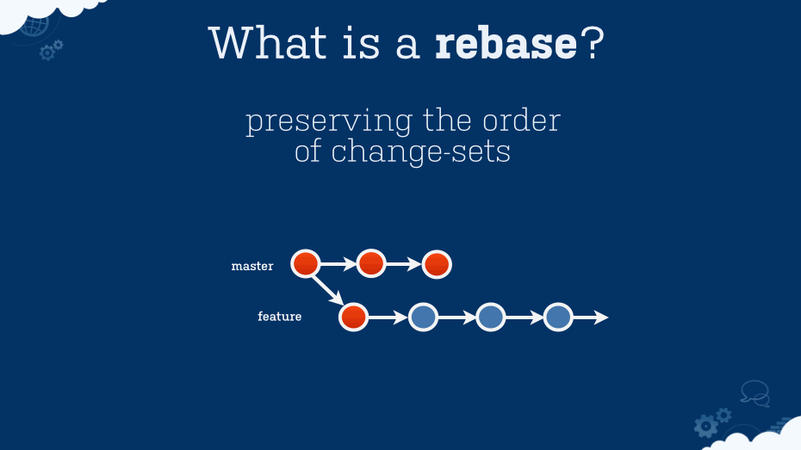
Git Pull Rebase
Operations Roadmap 2013
Big Data, Big Experience, Big Expertise - Fast
previous
next
previous
next

Slide 41
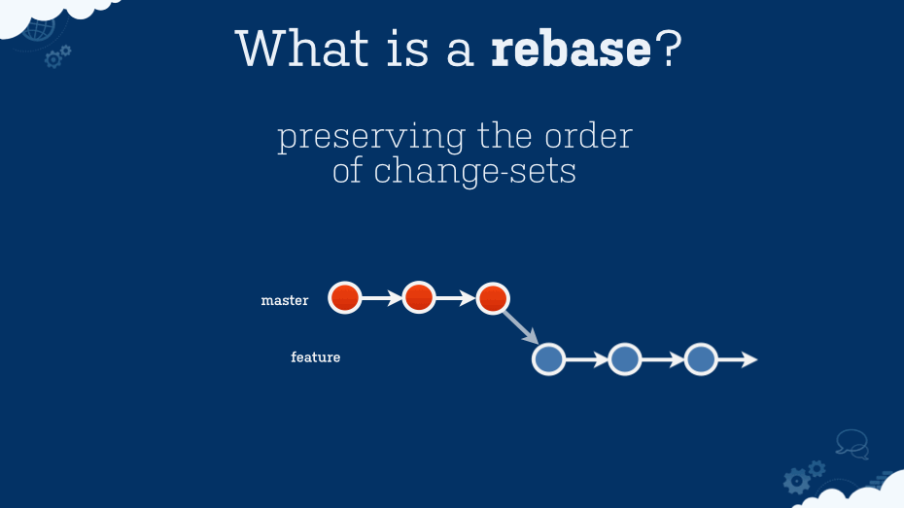
Git Pull Rebase
Operations Roadmap 2013
Big Data, Big Experience, Big Expertise - Fast
previous
next
previous
next

Slide 42
git cherry-pick
- pick commit from any branch and apply onto your branch
Operations Roadmap 2013
Big Data, Big Experience, Big Expertise - Fast
previous
next
previous
next

Slide 43
git reset (hard/soft)
- reset files
Operations Roadmap 2013
Big Data, Big Experience, Big Expertise - Fast
previous
next
previous
next

Slide 44
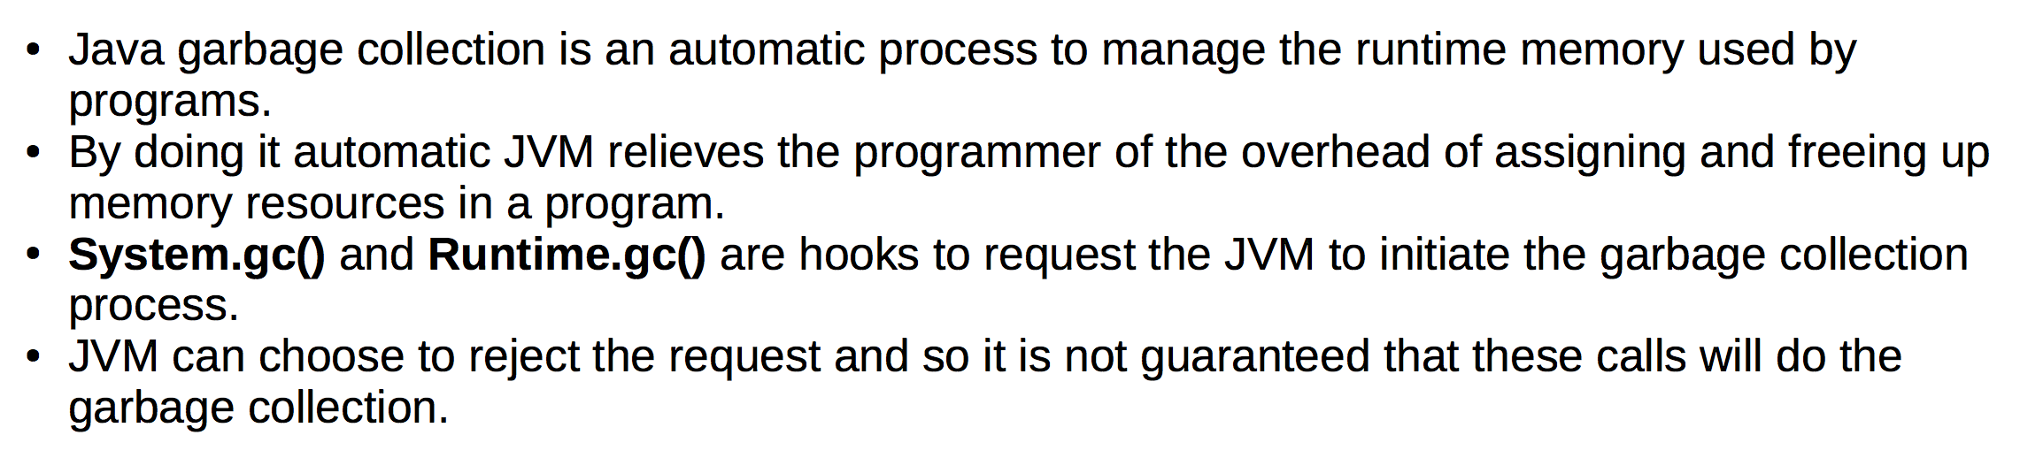
Garbage Collection
Operations Roadmap 2013
Big Data, Big Experience, Big Expertise - Fast
previous
next
previous
next

Slide 45
Pull Request
- send your changes to origin/upstream branch
Operations Roadmap 2013
Big Data, Big Experience, Big Expertise - Fast
previous
next
previous
next

Slide 46
Architecture In Organizations
master
Operations Roadmap 2013
Big Data, Big Experience, Big Expertise - Fast
previous
next
previous
next

Slide 47
Architecture In Organizations
master
Operations Roadmap 2013
Big Data, Big Experience, Big Expertise - Fast
previous
next
previous
next

Slide 48
Architecture In Organizations
develop
master
Operations Roadmap 2013
Big Data, Big Experience, Big Expertise - Fast
previous
next
previous
next

Slide 49
Architecture In Organizations
uat/stage
develop
master
Operations Roadmap 2013
Big Data, Big Experience, Big Expertise - Fast
previous
next
previous
next

Slide 50
Architecture In Organizations
uat/stage
develop
master
Operations Roadmap 2013
Big Data, Big Experience, Big Expertise - Fast
previous
next
previous
next

Slide 51
Architecture In Organizations
uat/stage
develop
release-team1
release-team2
release-team3
master
Operations Roadmap 2013
Big Data, Big Experience, Big Expertise - Fast
previous
next
previous
next

Slide 52
Architecture In Organizations
uat/stage
develop
release-team1
release-team2
release-team3
master
Operations Roadmap 2013
Big Data, Big Experience, Big Expertise - Fast
previous
next
previous
next

Slide 53
Architecture In Organizations
uat/stage
develop
release-team1
release-team2
release/DSE
master
Operations Roadmap 2013
Big Data, Big Experience, Big Expertise - Fast
previous
next
previous
next

Slide 54
Architecture In Organizations
uat/stage
develop
release-team1
release-team2
release/DSE
master
Operations Roadmap 2013
Big Data, Big Experience, Big Expertise - Fast
previous
next
previous
next

Slide 55
Architecture In Organizations
uat/stage
develop
release-team1
feature/JIRA-8921-small-desc-of-feature
release/DSE
master
Operations Roadmap 2013
Big Data, Big Experience, Big Expertise - Fast
previous
next
previous
next

Slide 56
Architecture In Organizations
uat/stage
develop
release-team1
feature/JIRA-8921-small-desc-of-feature
release/DSE
master
Operations Roadmap 2013
Big Data, Big Experience, Big Expertise - Fast
previous
next
previous
next

Slide 57
Architecture In Organizations
uat/stage
develop
release-team1
feature/JIRA-8921-small-desc-of-feature
release/DSE
master
Operations Roadmap 2013
Big Data, Big Experience, Big Expertise - Fast
previous
next
previous
next

Slide 58
Architecture In Organizations
uat/stage
develop
release-team1
feature/JIRA-8921-small-desc-of-feature
release/DSE
master
Operations Roadmap 2013
Big Data, Big Experience, Big Expertise - Fast
previous
next
previous
next

Slide 59
Architecture In Organizations
uat/stage
develop
release-team1
feature/JIRA-8921-small-desc-of-feature
feature developer
release/DSE
master
Operations Roadmap 2013
Big Data, Big Experience, Big Expertise - Fast
previous
next
previous
next

Slide 60
Architecture In Organizations
uat/stage
develop
release-team1
feature/JIRA-8921-small-desc-of-feature
release/DSE
master
Operations Roadmap 2013
Big Data, Big Experience, Big Expertise - Fast
previous
next
previous
next

Slide 61
Architecture In Organizations
uat/stage
develop
release-team1
release/DSE
master
Operations Roadmap 2013
Big Data, Big Experience, Big Expertise - Fast
previous
next
previous
next

Slide 62
Architecture In Organizations
uat/stage
develop
Tech lead
release-team1
release/DSE
master
Operations Roadmap 2013
Big Data, Big Experience, Big Expertise - Fast
previous
next
previous
next

Slide 63
Architecture In Organizations
uat/stage
develop
Tech lead
release-team1
release/DSE
master
Operations Roadmap 2013
Big Data, Big Experience, Big Expertise - Fast
previous
next
previous
next

Slide 64
Architecture In Organizations
uat/stage
develop
Tech lead
release-team1
release-team2
release/DSE
master
Operations Roadmap 2013
Big Data, Big Experience, Big Expertise - Fast
previous
next
previous
next

Slide 65
Architecture In Organizations
uat/stage
develop
release-team1
release-team2
release/DSE
master
Operations Roadmap 2013
Big Data, Big Experience, Big Expertise - Fast
previous
next
previous
next

Slide 66
Architecture In Organizations
uat/stage
develop
Dev ops
release-team1
release-team2
release/DSE
master
Operations Roadmap 2013
Big Data, Big Experience, Big Expertise - Fast
previous
next
previous
next

Slide 67
Architecture In Organizations
uat/stage
develop
release-team1
release-team2
release/DSE
master
Operations Roadmap 2013
Big Data, Big Experience, Big Expertise - Fast
previous
next
previous
next

Slide 68
Architecture In Organizations
uat/stage
develop
Dev ops
release-team1
release-team2
release/DSE
master
Operations Roadmap 2013
Big Data, Big Experience, Big Expertise - Fast
previous
next
previous
next

Slide 69
Architecture In Organizations
uat/stage
develop
release-team1
release-team2
release/DSE
master
Operations Roadmap 2013
Big Data, Big Experience, Big Expertise - Fast
previous
next
previous
next

Slide 70
Architecture In Organizations
uat/stage
develop
master
Operations Roadmap 2013
Big Data, Big Experience, Big Expertise - Fast
previous
next
previous
next

Slide 71
Architecture In Organizations
uat/stage
develop
release-team1
release-team2
release/DSE
master
Operations Roadmap 2013
Big Data, Big Experience, Big Expertise - Fast
previous
next
previous
next

Slide 72
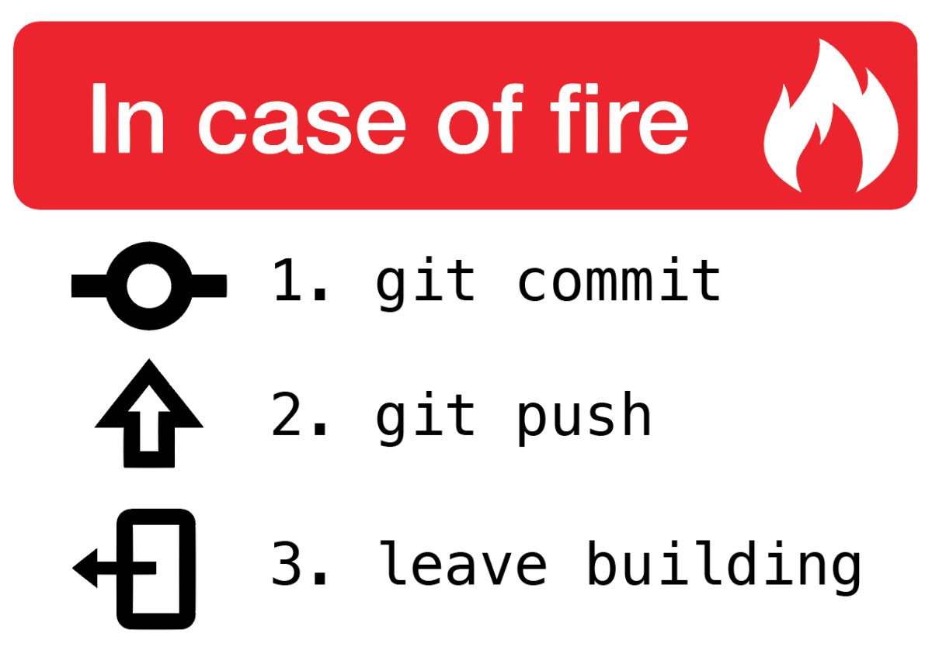
Operations Roadmap 2013
Big Data, Big Experience, Big Expertise - Fast
previous
next
previous
next

Slide 73

Operations Roadmap 2013
73
Big Data, Big Experience, Big Expertise - Fast
previous
next
previous
next

